Slide 1

Time Series

Slide 2
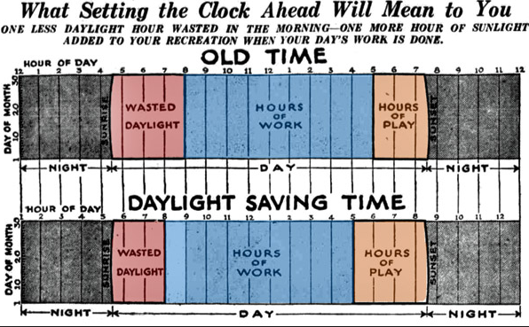
[placeholder image]

Slide 3
70% of business data
Notes:
Estimated that 70% of business data is time series. (Few, 2007) find actual research to cite for this!!

Slide 4
Time Series Data Properties
Discrete vs. interval
Linear vs. cyclical
Ordinal vs. continuous
Ordered vs. branching vs. multiple perspectives
Notes:
Cite Muller and Schumann 2003, from Frank, 1998 from Stasko slide

Slide 5
Measuring Change
Discrete vs. interval
Linear vs. cyclical
Ordinal vs. continuous
Ordered vs. branching vs. multiple perspectives
Notes:
Cite Muller and Schumann 2003, from Frank, 1998 from Stasko slide

Slide 6
Characteristics of Change
Notes:
Few identifies several characteristics of change for time series data.
https://www.perceptualedge.com/articles/visual_business_intelligence/visualizing_change.pdf

Slide 7
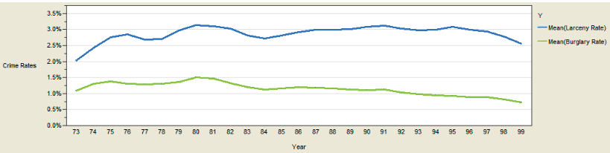
Magnitude
Chart Source: Few, 2007. Visualizing Change.

Slide 8
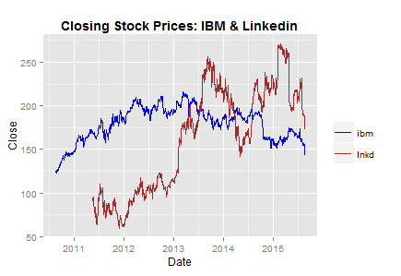
Shape
[Example Placeholder Image]
Chart Source: https://www.r-bloggers.com/plotting-time-series-in-r-using-yahoo-finance-data/
Notes:
https://www.r-bloggers.com/plotting-time-series-in-r-using-yahoo-finance-data/

Slide 9
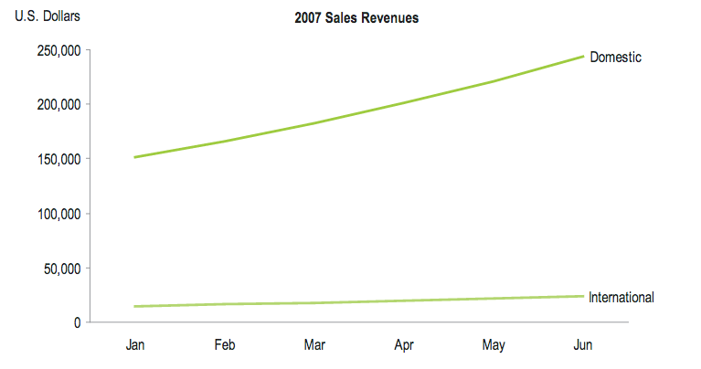
Velocity
Chart Source: Few, 2007. Visualizing Change.

Slide 10
Velocity
Chart Source: Few, 2007. Visualizing Change.

Slide 11
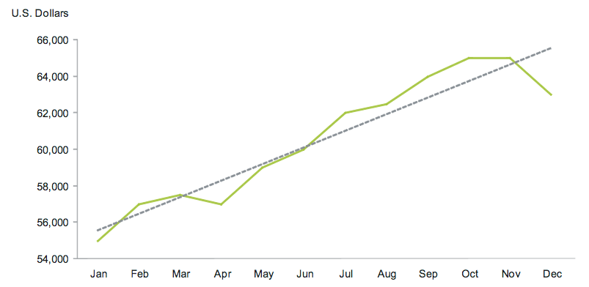
Direction
Chart Source: Few, 2007. Visualizing Change.

Slide 12
Motion
Notes:
Add Image

Slide 13
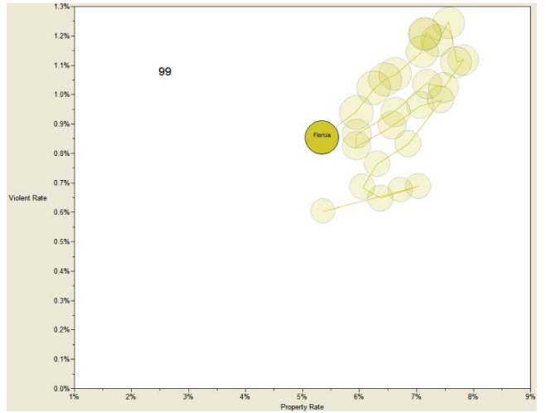
[Example Placeholder Image]
Chart Source: Few, 2007. Visualizing Change.

Slide 14
Linear

Slide 15
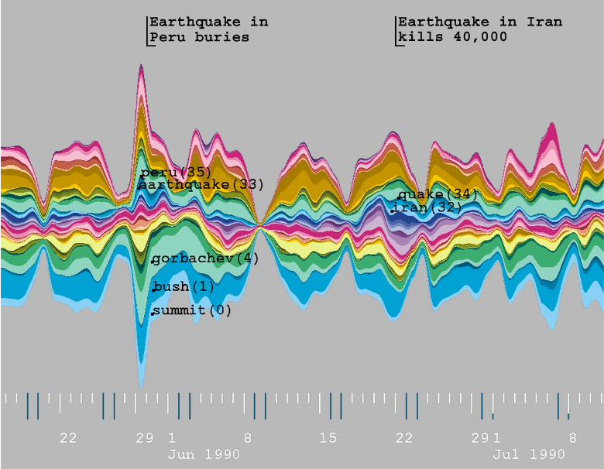
Chart Source: Havre et al., 2000. ThemeRiver: Visualizing Theme Changes Over Time.
Notes:
Themeriver

Slide 16
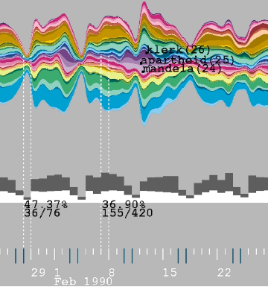
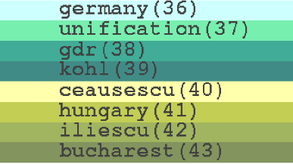
Chart Source: Havre et al., 2000. ThemeRiver: Visualizing Theme Changes Over Time.
Notes:
http://www.ifs.tuwien.ac.at/~silvia/wien/vu-infovis/references/havre-ieeeinfovis00.pdf

Slide 17
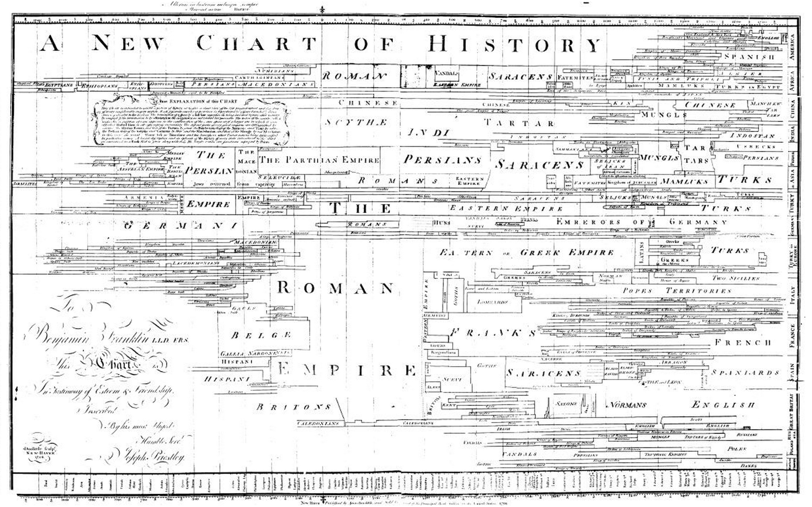
Joseph Priestly

Slide 18
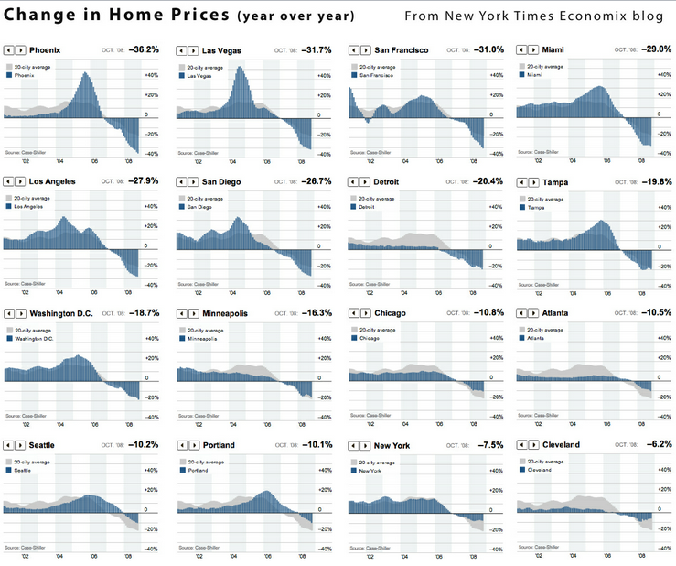
feed://evalcentral.com/feed/

Slide 19
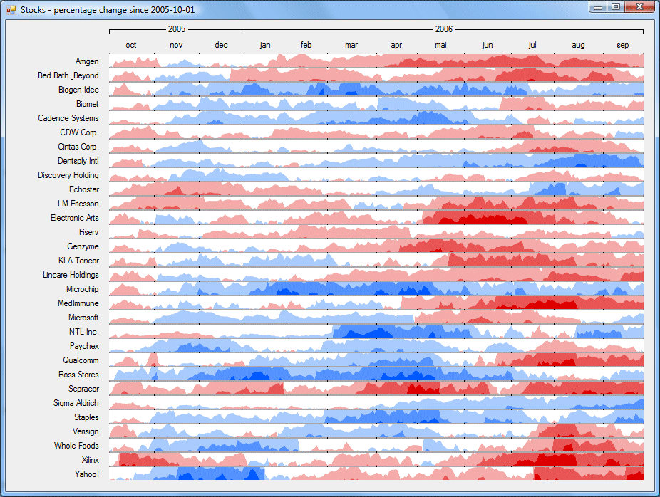
http://panopticon2.moneycoach.biz/assets/img/screenshot_horizongraph_large.gif

Slide 20
Cyclical

Slide 21
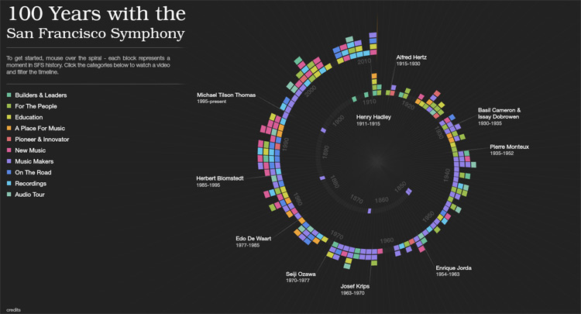
http://thewhyaxis.info/content/13-music/music-in1.jpg

Slide 22
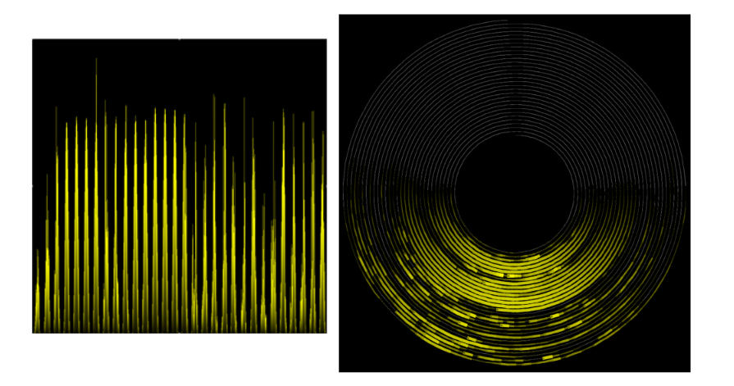
Diagram Source: Weber, M., Alexa, M., & Müller, W. (2001, October). Visualizing time-series on spirals. In Infovis (Vol. 1, pp. 7-14).
Notes:
http://ieg.ifs.tuwien.ac.at/~aigner/teaching/ws06/infovis_ue/papers/spiralgraph_weber01visualizing.pdf

Slide 23
Events

Slide 24
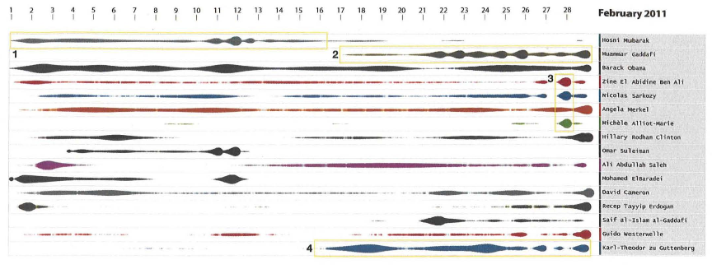
Chart Source: Krstajic et al., 2011. CloudLines: Compact Display of Event Episodes in Multiple Time Series..
Notes:
https://kops.uni-konstanz.de/bitstream/handle/123456789/17483/Keim.pdf?sequence=1&isAllowed=y

Slide 25
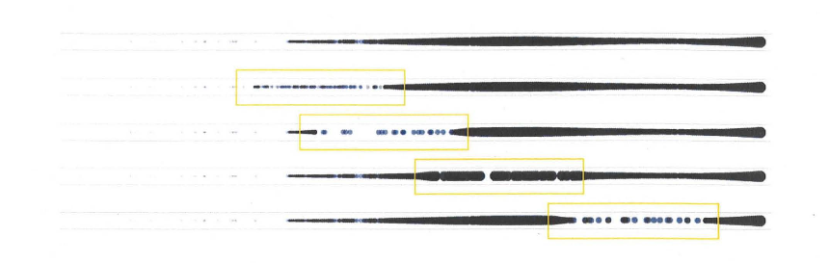
Chart Source: Krstajic et al., 2011. CloudLines: Compact Display of Event Episodes in Multiple Time Series..
Notes:
https://kops.uni-konstanz.de/bitstream/handle/123456789/17483/Keim.pdf?sequence=1&isAllowed=y

Slide 26
Time Analytic Algorithms

Slide 27
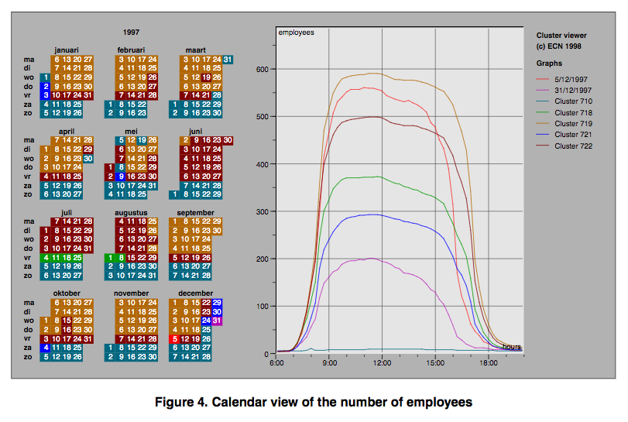
Clustering
Van Wijk & Selow, 1999
Notes:
http://www.cs.ubc.ca/~tmm/courses/cpsc533c-06-fall/readings/vanwijk99cluster.pdf

Slide 28
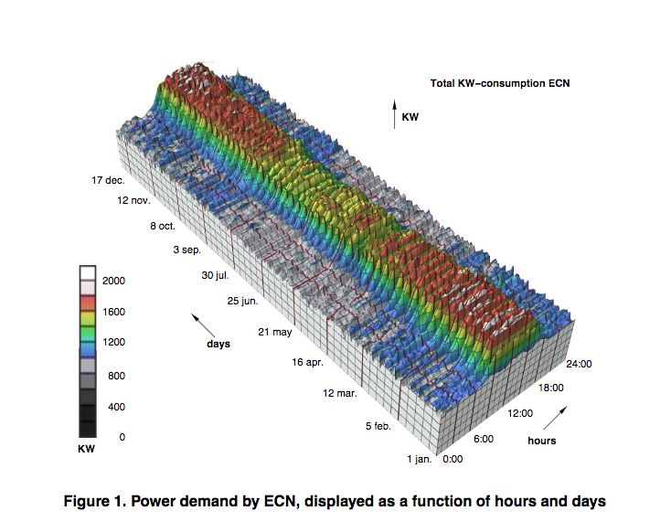
Clustering
Van Wijk & Selow, 1999
Notes:
http://www.cs.ubc.ca/~tmm/courses/cpsc533c-06-fall/readings/vanwijk99cluster.pdf

Slide 29
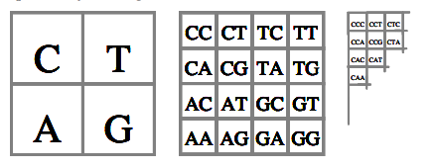
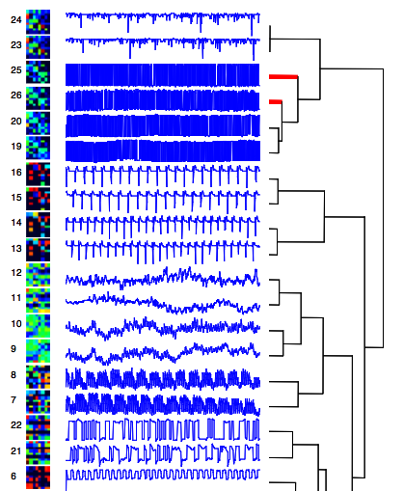
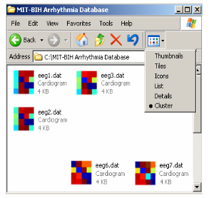
Time Series Bitmaps
Kumar et al., 2005
Notes:
http://citeseerx.ist.psu.edu/viewdoc/download?doi=10.1.1.413.4650&rep=rep1&type=pdf

Slide 30


